Slide 1


Slide 2
K-Nearest Neighbor(KNN)

Slide 3
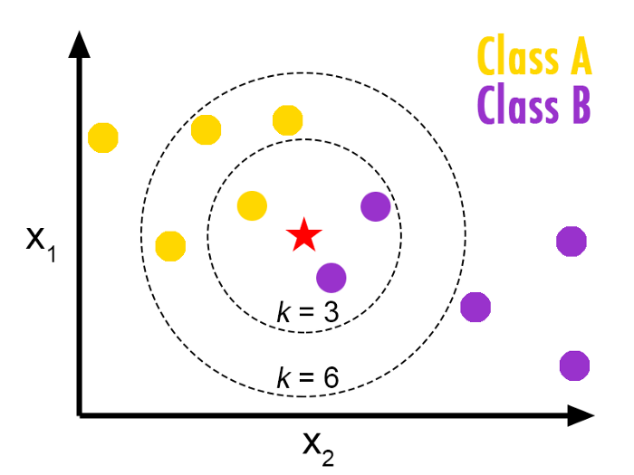
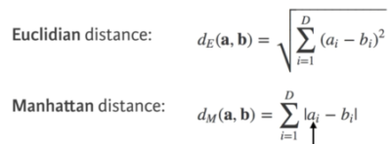
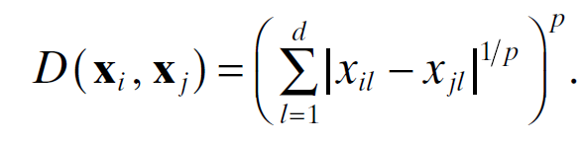
K-Nearest Neighbor(KNN)
The K-NN algorithm works by finding the K nearest neighbors to a given data point based on a distance metric, such as Euclidean distance. The class or value of the data point is then determined by the majority vote or average of the K neighbors.

Slide 4
Example
Name | Cigarettes | Weight | Heart Attack
A | 7 | 70 | Bad
B | 7 | 70 | Bad
C | 3 | 40 | Good
D | 1 | 40 | Good
Test Data → Name=E , Cigarettes=3, Weight=70, Heart Attack =??
Given K=1

Slide 5
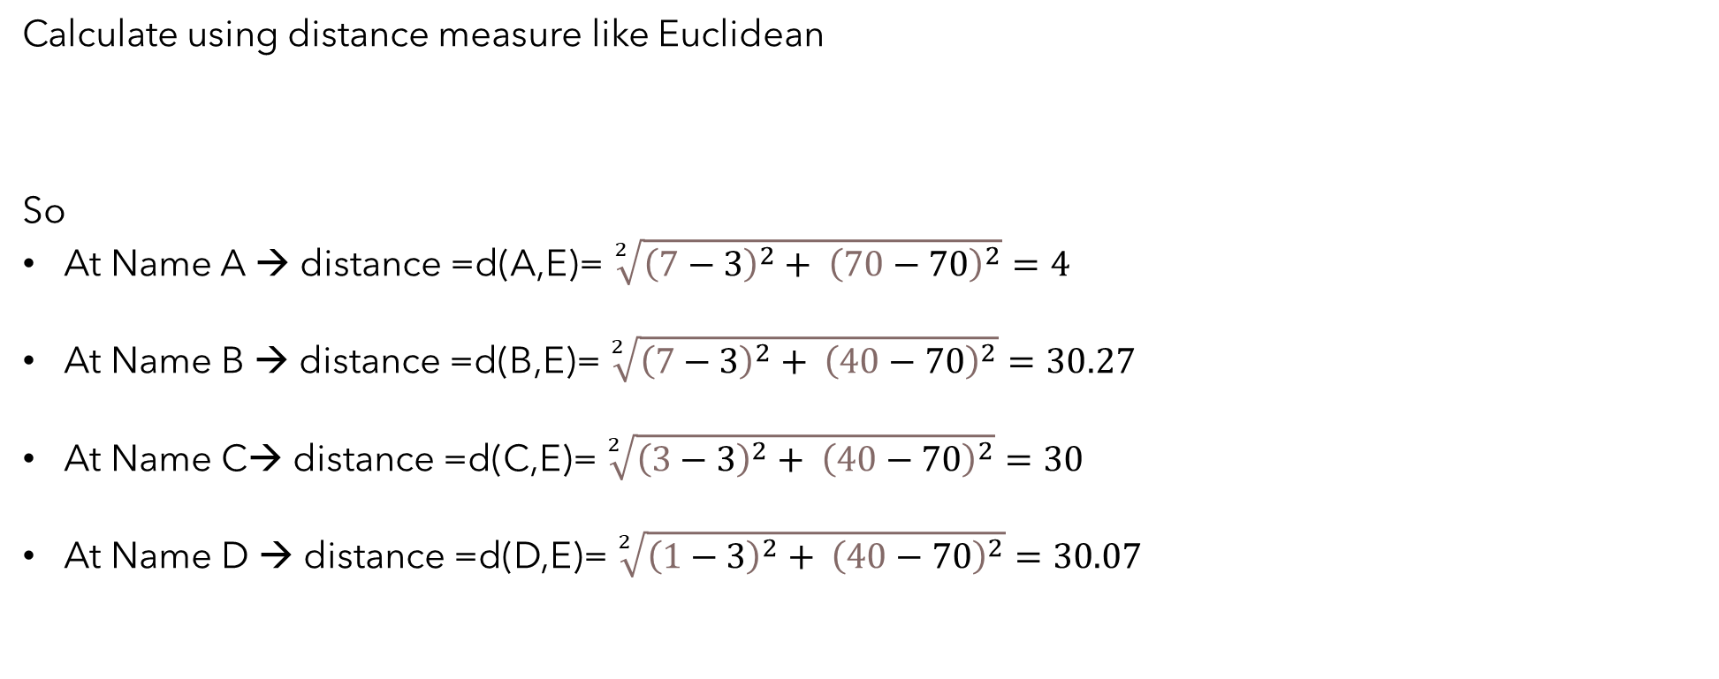
Calculate using distance measure like Euclidean
So
At Name A → distance =d(A,E)= $\sqrt[2]{{\left(7−3\right)}^{2}+ {\left(70−70\right)}^{2}}=4$
At Name B → distance =d(B,E)= $\sqrt[2]{{\left(7−3\right)}^{2}+ {\left(40−70\right)}^{2}}=30.27$
At Name C→ distance =d(C,E)= $\sqrt[2]{{\left(3−3\right)}^{2}+ {\left(40−70\right)}^{2}}=30$
At Name D → distance =d(D,E)= $\sqrt[2]{{\left(1−3\right)}^{2}+ {\left(40−70\right)}^{2}}=30.07$
$$d\left(x , y\right)=\sqrt[2]{{\left(x1−x2\right)}^{2}+ {\left(y1−y2\right)}^{2}}$$

Slide 6
Name | Cigarettes | Weight | Heart Attack | Distance
A | 7 | 70 | Bad | 4
B | 7 | 70 | Bad | 30.27
C | 3 | 40 | Good | 30
D | 1 | 40 | Good | 30.07
E | 3 | 70 | ?
Then we Must Sort Distance

Slide 7
Name | Cigarettes | Weight | Heart Attack | Distance | Rank
A | 7 | 70 | Bad | 4 | 1
C | 3 | 40 | Good | 30 | 2
D | 1 | 40 | Good | 30.07 | 3
B | 7 | 70 | Bad | 30.27 | 4
E | 3 | 70 | ?
When we look first at smallest distance “4” we Heart Attack =Bad
we can Predict that Heart Attack =Bad Based on smallest distance

Slide 8
Name | Cigarettes | Weight | Heart Attack
A | 7 | 70 | Bad
B | 7 | 70 | Bad
C | 3 | 40 | Good
D | 1 | 40 | Good
E | 3 | 70 | Bad

Slide 9

Thank you

